Slide 1
Molecular Interaction Networks
Service providers at the BioHackathon:
DIP (Lukasz Salwinski, UCLA)
STRING/STICH (Michael Kuhn, EMBL)
IntAct (Bruno Aranda, EBI)
The IMEx consortium is a group of major public interaction data providers sharing curation effort and exchanging completed records on molecular interaction data. DIP, IntAct and MINT are full-fledged members. Others coming soon.
Service consumers:
Cytoscape (Keichiro Ono)
CellDesigner (Akira Funahashi, Keio Univ. & SBI )

Slide 2
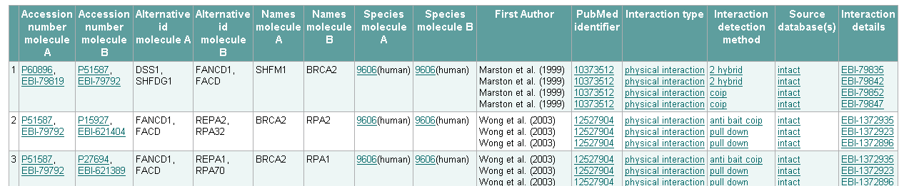
Molecular Interaction Networks
Exchange formats
Exchange formats is not an issue. Standards already exist.
- PSI-MI XML 2.5 (aka MIF - XML based) – Complete information.
- MITAB (Tabulated data) – Contains reduced information but still useful to some user profiles
Web Services
Some providers have web services already (e.g. IntAct, STRING/STICH, others not), and they are not compatible.

Slide 3
Molecular Interaction Networks
Standard WSDL -> project PSICQUIC
Define a standard WSDL for a common Web Service interface -> project PSICQUIC
  Done: the WSDL has been created, containing a comprehensive set of methods that return data in the two available formats
  Issue: returned XML can be big (up to hundreds of Mb). Results are paginated so each invocation returns a limited amount of Interaction Data.
  Cytoscape can already understand the output of the service, as it works with the standard formats.
  So, we could have a common client to rule them all!

Slide 4
Molecular Interaction Networks
PSICQUIC WSDL Methods:
getByInteractor (dbRef)
getByInteraction (dbRef)
getByInteractorList (dbRefList)
getByInteractionList (dbRefList)
getByBetweenList (dbRefList)
getByQuery (query)
getVersion
getSupportedDataTypes
All queries can be paginated, and exceptions have been defined too.

Slide 5
Molecular Interaction Networks
Common Query Language
Define a standard Common Query Language for interaction data retrieval.
  IntAct has created a generic Lucene based query language, which is currently used by Cytoscape (and others). It searches on a PSI MITAB file, so it could be used by anybody (and of course, open-source!)
  No further work has been done on this within the providers.
Example: “id:P12345 species:human”

Slide 6
Molecular Interaction Networks
Use-case gathering from clients
Many issues automatically resolved by using the standard formats.
Problem (use-case from Cytoscape): cytoscape uses identifiers that the providers not necessarily contain (e.g. NCBI identifiers). The IMEx consortium defines Uniprotkb and Refseq as the recommended identifiers. Mapping would be needed.

Slide 7
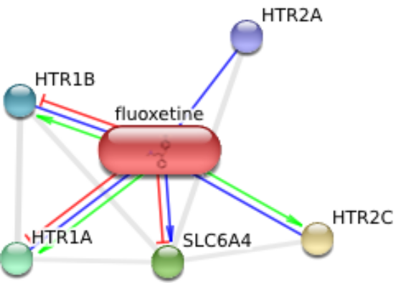
STRING/STITCH
REST API
  get interaction network in PSI-MI 2.5 format: can be used in Cytoscape
  resolve items; get abstracts
SOAP API
  with Soaplab2: partially done, works in Taverna
  PSICQUIC WSDL: to be implemented

Slide 8
ありがとう

